Slide 1
Gender Review Behavior on YELP
BY MARY-JANE, TOMISLAV AND AUKJE

Slide 2
Summary
MOTIVATION:
Are there gender differences on YELP?
The answer to these questions may help restaurants better target their audience.
QUESTIONS:
Q1: Who reviews more often and are men and women perceived differently by their peers?
Q2: Do men review restaurants differently from women when it comes to the type of restaurants they review (cheap to expensive) and the ratings they give (1 to 5 stars)
Q3: How is review behavior related to local economic factors (avg household income/ZIP)
CONCLUSIONS:
Q1: Women have more fans, but also review more often
Q2: There is a significant difference between men and women in
the type of restaurants they rate (men rate more $ and women more $$ restaurants)
the review rating they assign (women rate ‘higher’)
Q3:
YELP reviews are affected by gender and where you live!

Slide 3
Q1a: Who reviews more often?
Data Sources:
Three .json downloads containing data on YELP users, businesses and reviews (year 2000-2015): found on Kaggle
Name to gender dataset received from XXXX
Some problems we encountered:
Wanted to download the most recent Yelp review dataset (up to 2018), but couldn’t figure out how to open a TAR file.
Solution: Found a smaller dataset published in 2015. Someone converted TAR files to JSON ready files

Slide 4
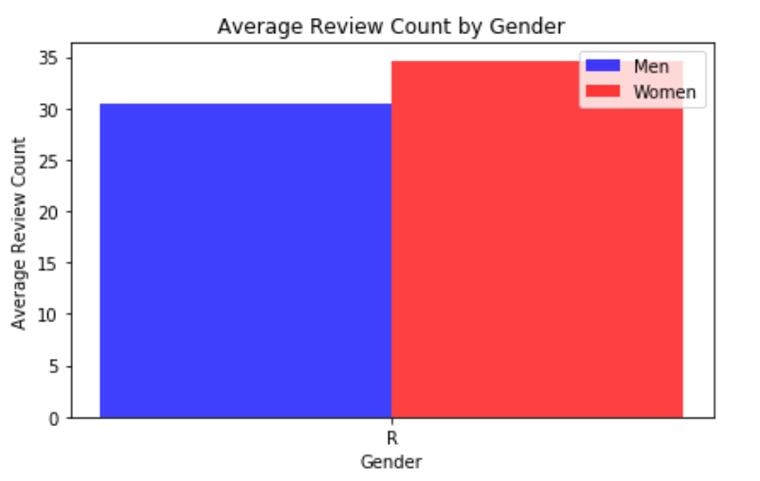
Q1a: Who reviews more often?
Answer?
Conclusion: Women review more often than men.

Slide 5
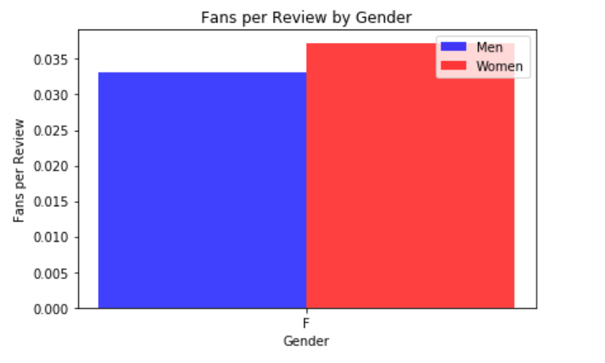
Q1b: Who has more fans?
Problem encountered:
A person is more likely to have more fans if they review more often. Since women systematically review more often than men, if we don’t scale by the number of reviews, we may find a mechanical relationship between women and fans.
Solution: Scale variables of interest by # of reviews by user
Answer:
Conclusion: Controlling for # of reviews written, women still have more fans than men.
Practical Implication: Restaurants should try to target women more often than men, since women are followed by more people on average.

Slide 6
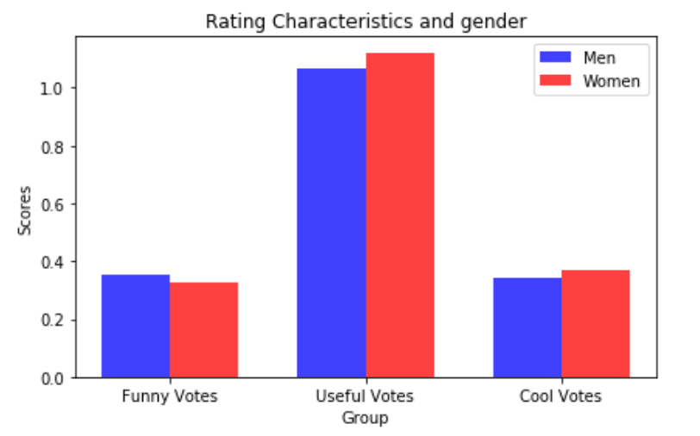
Q1c: Are there rating differences between men and women?
Answer?
Conclusion: Women provide more useful and cool votes, but men are funnier.

Slide 7
Q2: Gender and Review Behaviour
Question: Do men review restaurants differently from women when it comes to
the type of restaurants they review (cheap to expensive)
the ratings they give (1 to 5 stars)
Data Sources:
One .csv file containing close to 70.000 names and their associated gender (male, female, both or unknown)
One .csv with St. Louis zip codes (later expanded to 100 largest populations US Zipcodes)
Two Yelp API’s (one with business data and one with review data)
Some problems we encountered:
the business_id’s in the .JSON flat files didn’t match the online API business_id’s. Business_id’s changed after YELP rolled out a new version of their website (V2 > V3)
Using lat/long for St. Louis area causes overlap, because the YELP API uses a radius to find 20 businesses per call > Remove duplicates
Sample size was too small as results differed by day. Changed Zip-code file to include 100 largest population US Zip codes
API returned ‘empty’ records when no reviews were found for a business, or ‘empty’ fields for price e.g. causing code to fail > Try/Except necessary

Slide 8
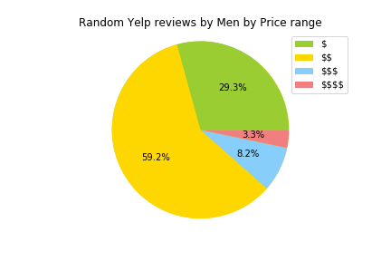
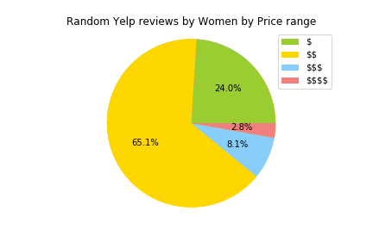
Q2: Gender and Review Rating Results
Businesses: 1669, Reviews: 3973 (2567 women vs 1711 men), p=0.04491458
Conclusion: Men tend to rate more $ restaurants vs Women who write significantly more reviews about $$ restaurants.

Slide 9
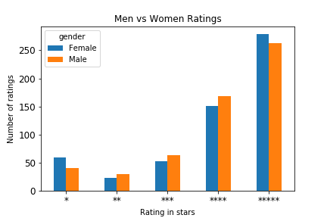
Q2: Gender and Review Rating Results
Reviews: 3422 (1711 men vs 1711 women), p = 0.03397372
Conclusion: Women rate restaurants more extreme when they are either really good or really bad

Slide 10
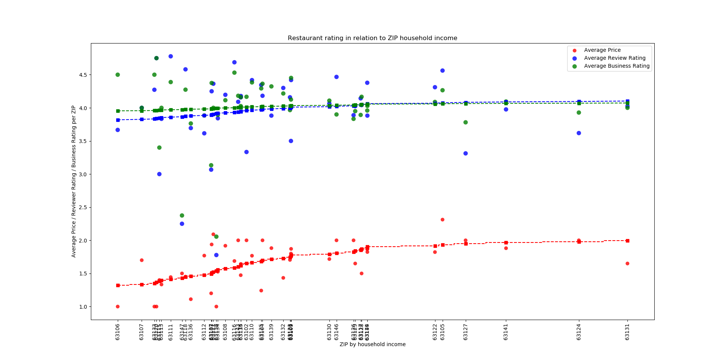
Q3: Location, Gender and Income
Is there a visible relation between census data, voting split and establishment ratings.

Slide 11
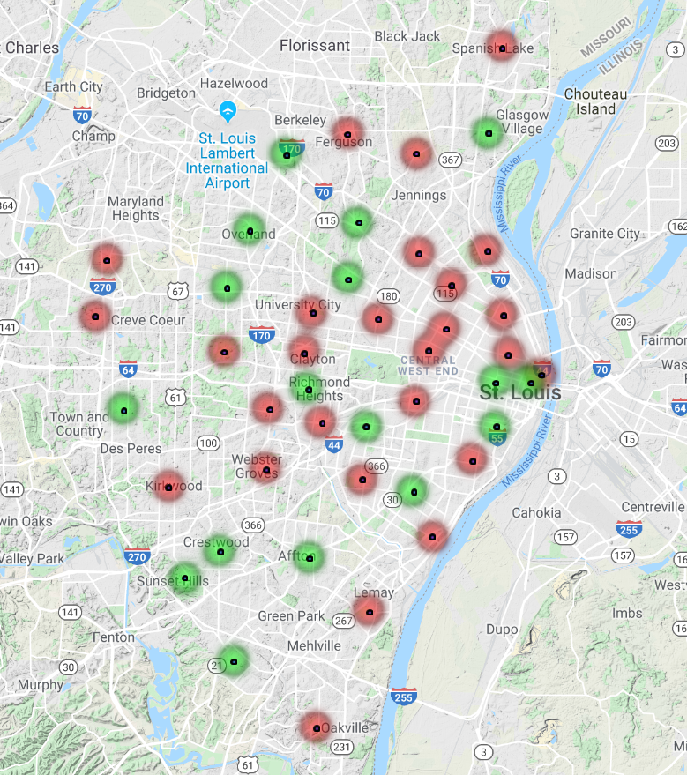
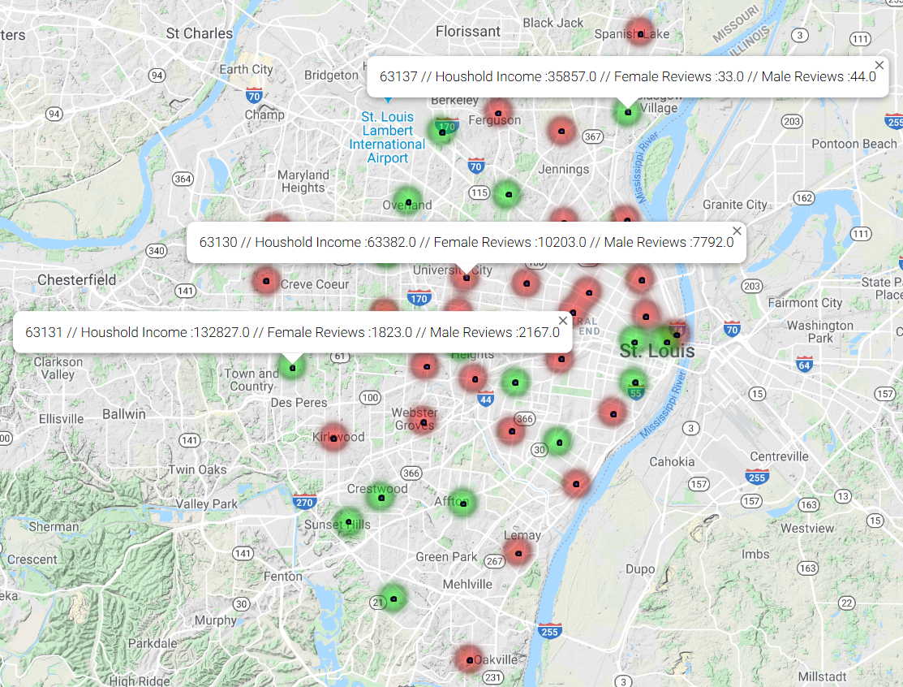
Q3: Location, Gender and Voting

Slide 12
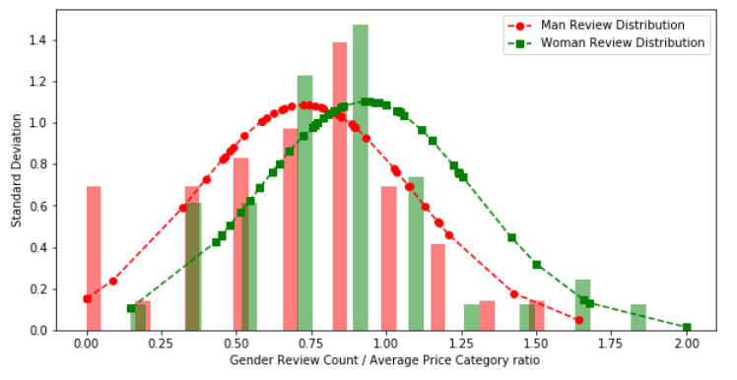
Q3: Gender and Location dependant price structure
44 Data Points aggregated by ZIP , T = 2.592202603 ,p=0.011204503
Conclusion: Women are more likely to rate $$$ restaurants in more affluent areas more frequently, while man are more vocal in $ establishments (bargain hunting) .

Slide 13
Wrapping up
Some difficulties and how we dealt with them:
Linking the JSON files ot the Yelp API to find more detailed information about restaurants was a problem due to an upgrade that took place over time.
JSON reviewed all sorts of businesses, YELP API just restaurants/food related establishments
This process also exposed the deficiencies of YELP API when it comes to location based queries. Most likely in the future this should be done in combination with Google geolocation services.
We could have spend more time thinking about the end results before individually going out to find data, resulting in some overlap in results. However, this also lead to new insights (e.g. greater sample size was needed)
Additional questions that could be researched:
compare east coast / mid west / west coast review behaviour
analyse the categories that define the type of restaurant (e.g. lunch, coffee, bar etc).
see if there’s a relationship between alcohol being served and the rating restaurants recieve!
Getting a better insight in transient nature of establishments. Do they cater to local population on not,.

Slide 14
Questions
Open-floor Q&A with the audience

